Slide 1
Військові меморіали і поховання Першої світової війни на Закарпатті Юрій Фатула, доцент, канд.мед.наук Ужгородський національний університет Факультет післядипломної освіти та доуніверситетської підготовки. Голова громадської організації “Memento bellum”
Military memorials and cemeteries of World War I in Transcarpathia (Ukraine)
Juriy Fatula, associate professor, Ph.D.
Uzhhorod National University
Faculty of Postgraduate education
Chairman of Public organization “Memento bellum”

Slide 2
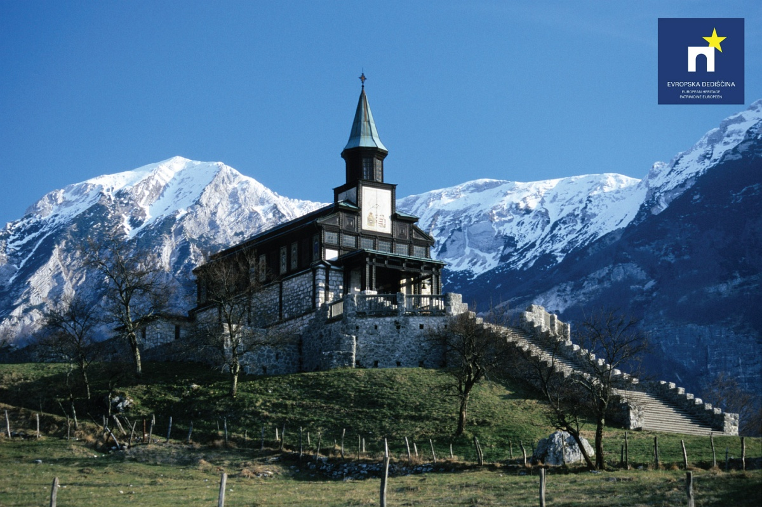
Slovenia, 2019

Slide 3
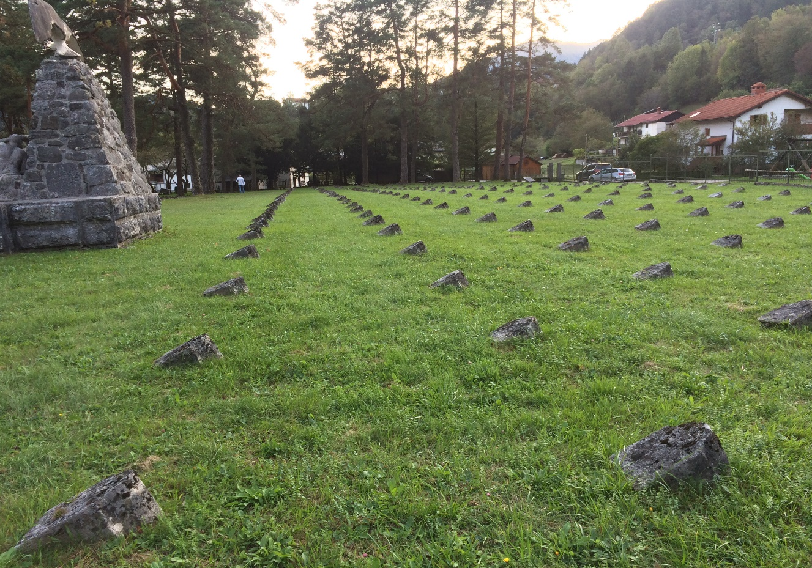
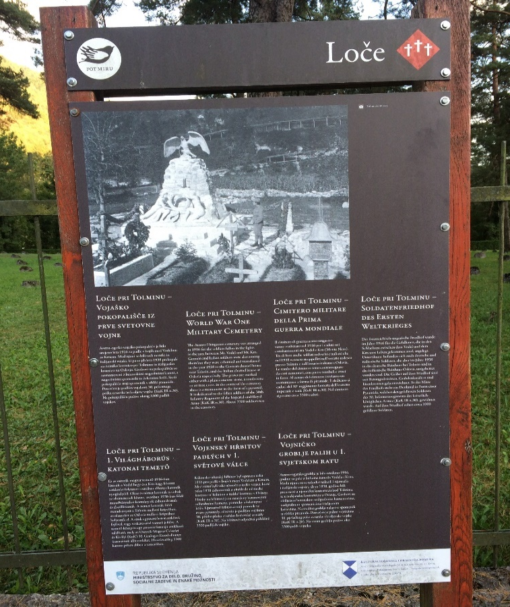
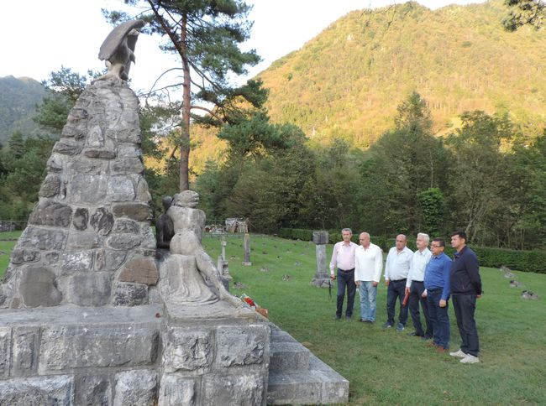
Slovenia, 2019

Slide 4
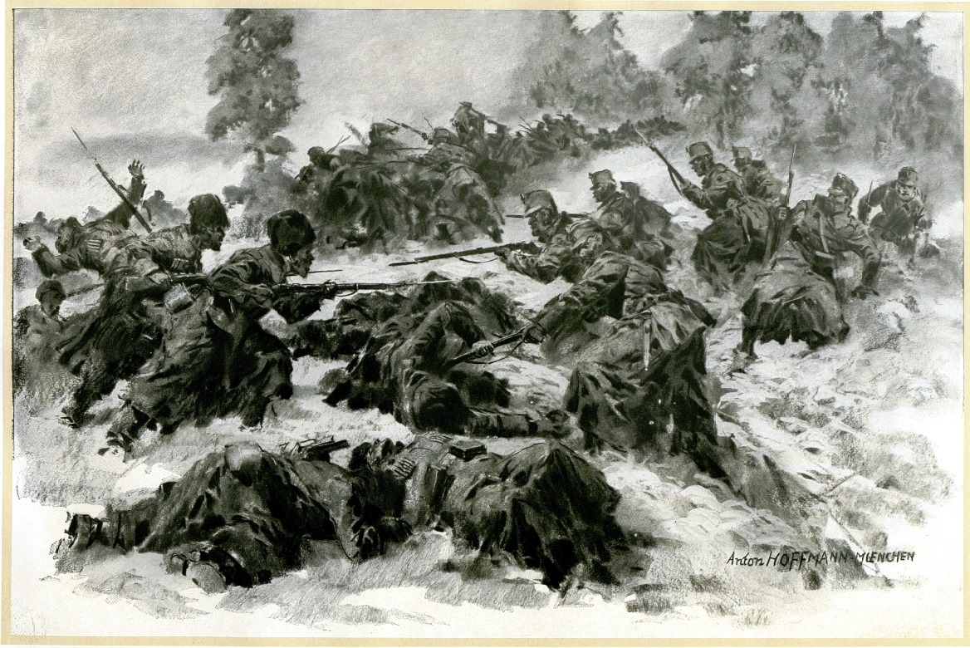
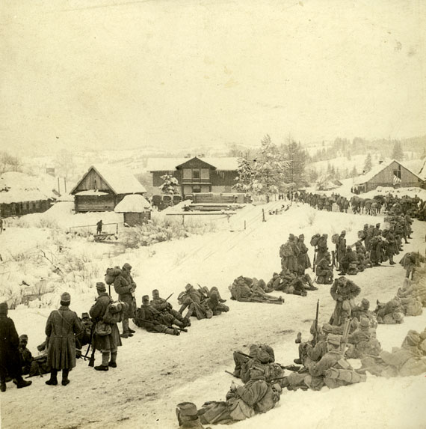
In September 1914 – May 1915, then August 1916 the severe battles took place in mountainous part of Transcarpathia (Uzsok, Verecke, Torun, Jasinja Passes, Cseremcha and Kukul Mountains). Result: 221 large and small military cemeteries.

Slide 5
During World War I 12.000. (12 thousands) soldiers (7.000. unknown) were buried on two military cemeteries in Uzhhorod. “Memento bellum” investigation of all 180 thousands mortal cards from Czech military archives (Prague) revealed 3459 known warriors from 19 present-day European states.
Distribution of buried soldiers according to present-day European states
Hungary | 906 | 26,2%
Romania | 615 | 17,8%
Ukraine | 347 | 10%
Czechia | 321 | 9,3%
Slovakia | 255 | 7,4%
Austria | 222 | 6,4%
Serbia | 146 | 4,2%
Croatia | 112 | 3,2%
Poland | 62 | 1,8%
Bosnia | 52 | 1,5%
Slovenia | 33 | 1%
Russia | 32 | 0,9%
Italy | 15 | 0,4%

Slide 6
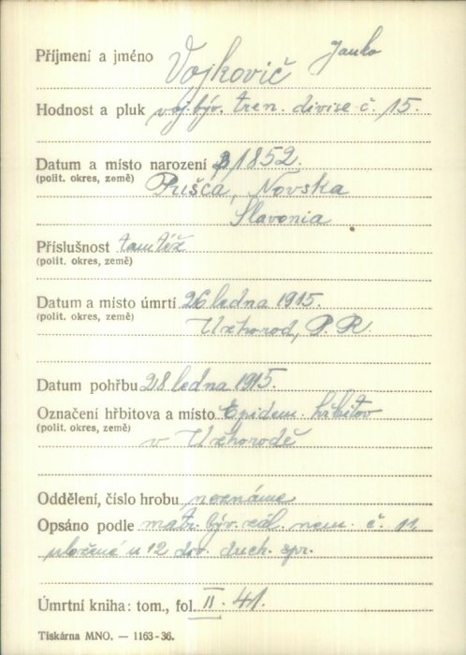
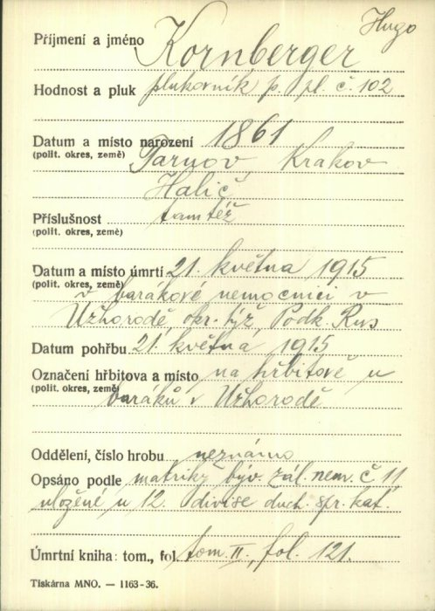
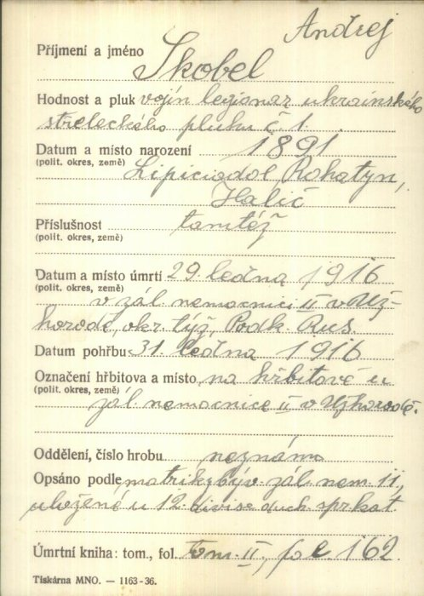
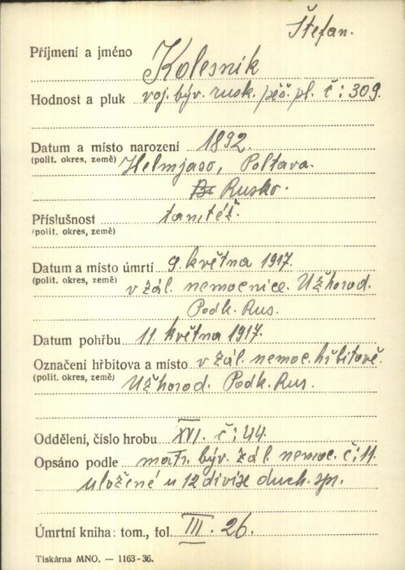
Mortal cards from Czech military archives (Prague), vuapraha.cz

Slide 7
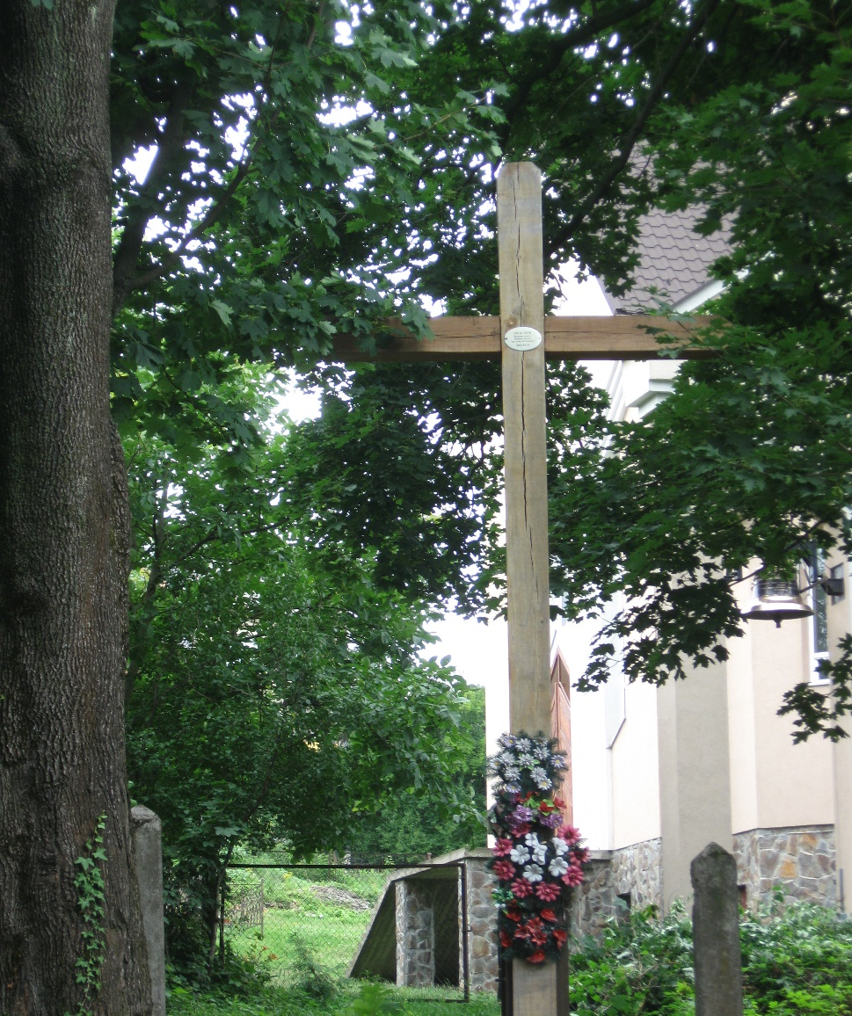
Military cemetery No. 1, Uzhhorod, microdistrict “Sachta”. 1.003. (one thousand) men were buried on 1914 – 1918.

Slide 8
Posádkový vojenský cintorín. Architektúrny project (2014).

Slide 9
Posádkový vojenský cintorín. Architektúrny project (2018).

Slide 10
Military cemetery No. 2, near Uzhhorod railway station (11.000. men) Razed to the ground on 1965

Slide 11
Dorian Feigenbaum (1887, Lemberg – 1937, New York) – famous scientist-psychoanalytic. During World War I – army doctor. 10 months (5.11.1914 – 26.08.1915) – head of infectious hospital in Ungvar (Uzhhorod).

Slide 12
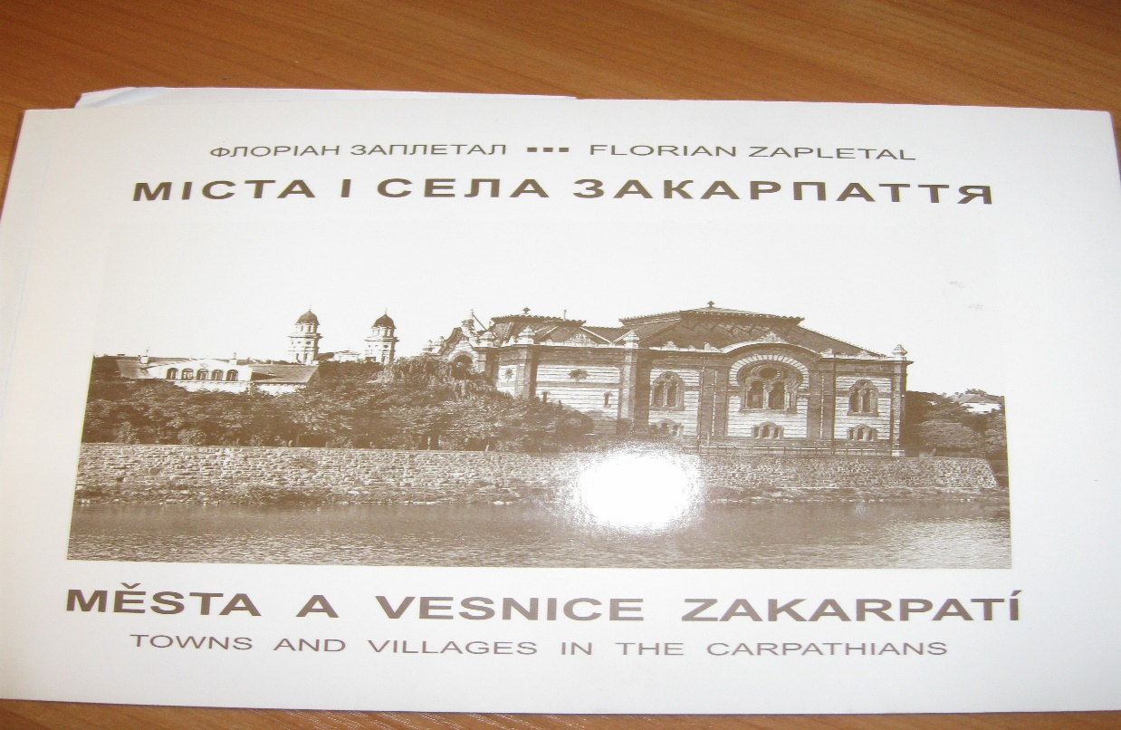
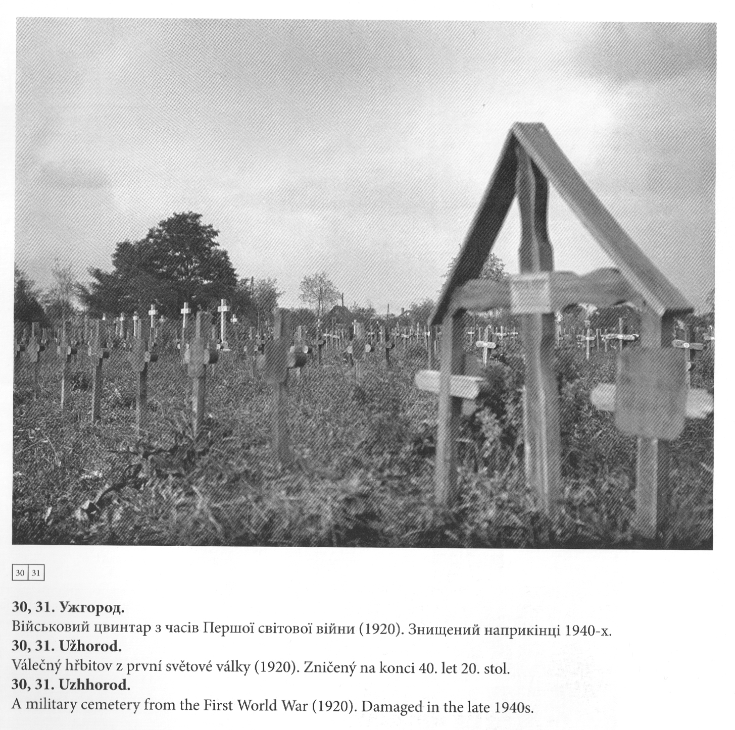
Military cemetery No. 2 (1920 – 1945)

Slide 13
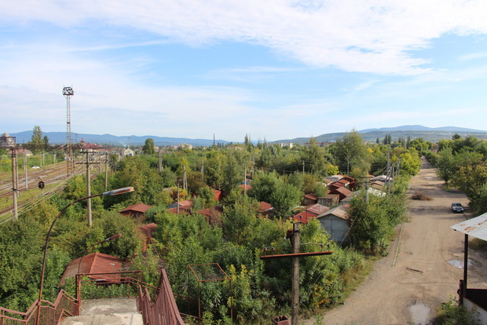
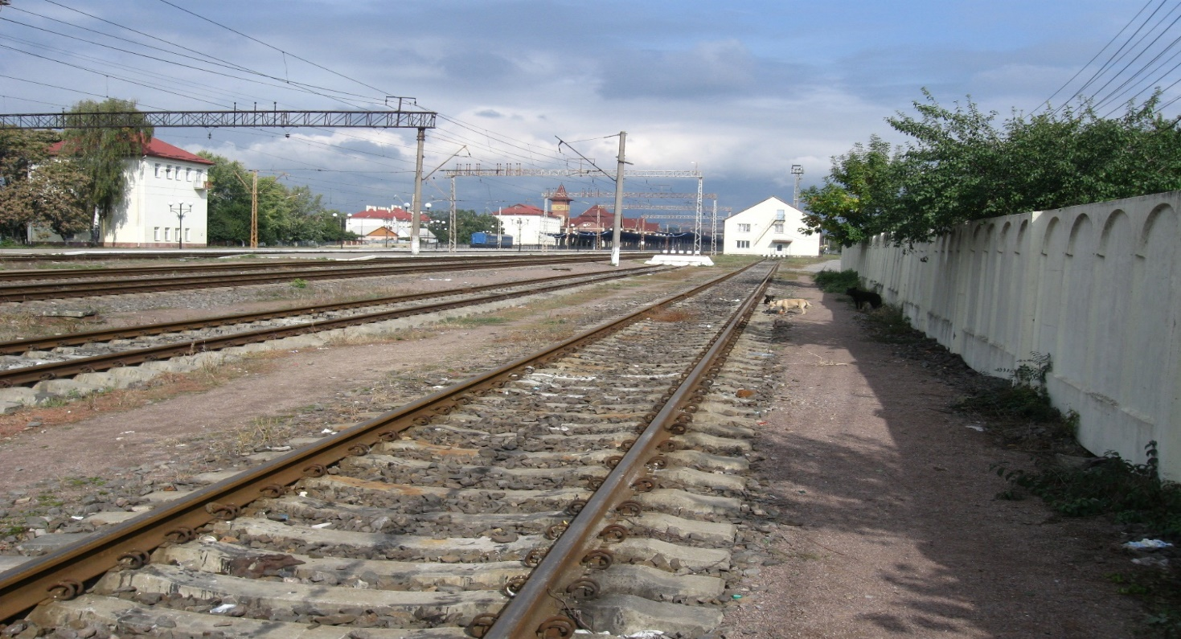

Slide 14
Symbolic marble cross near military cemetery No. 2 in Uzhhorod

Slide 15
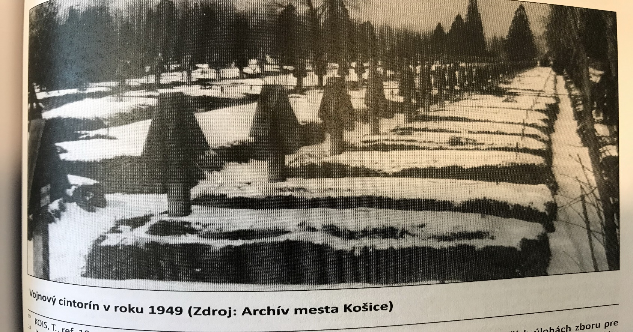
Largest military cemeteries of WWI in East Europe
Location | Number of buried soldiers
Olomouc (Czechia) | 3.218.
Debrecen (Hungary) | 3.417.
Krakow (Poland) | About 7.000.
Kosice (Slovakia) | About 7.500.
Lviv (Ukraine) | 10.000.
Uzhhorod (Ukraine) | 12.000.

Slide 16
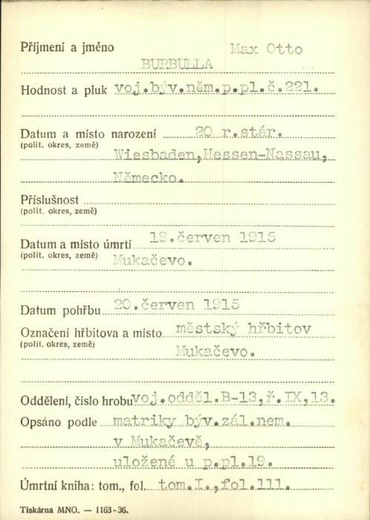
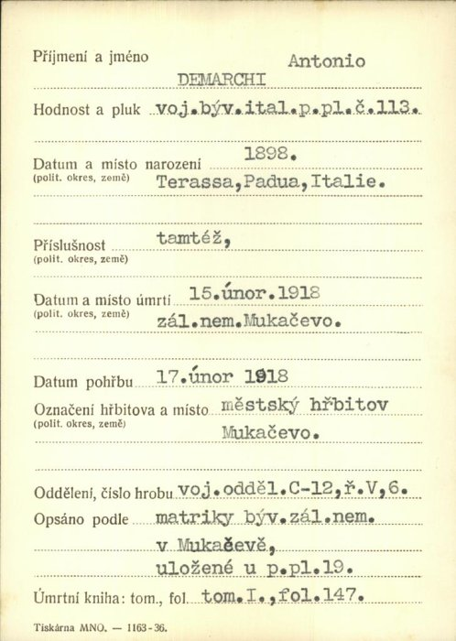
Military cemetery in Mukachevo. 1100 soldiers of Austro-Hungarian, German and Russian armies were buried

Slide 17
Number of World War I military cemeteries and buried soldiers in Mizhhirja district of Transcarpathian region of Ukraine according to the documents of Czech military archive (Prague)
Location of military cemeteries | Number of cemeteris | Number of buried soldiers
Торунський перевал | 2 | 400
Торунь | 1 | 300
Міжгір′я | 3 | 510
Завійка | 2 | 55
Тюшка | 1 | 53
Прислоп | 1 | 31
Синевирська Поляна | 1 | 24
Верхній Студений | 1 | 17
 | 12 | 1390

Slide 18
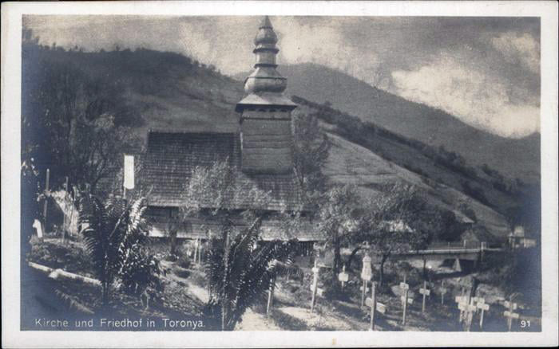
Military cemetery in Torun (near wooden church built in 1809) 300 buried soldiers

Slide 19
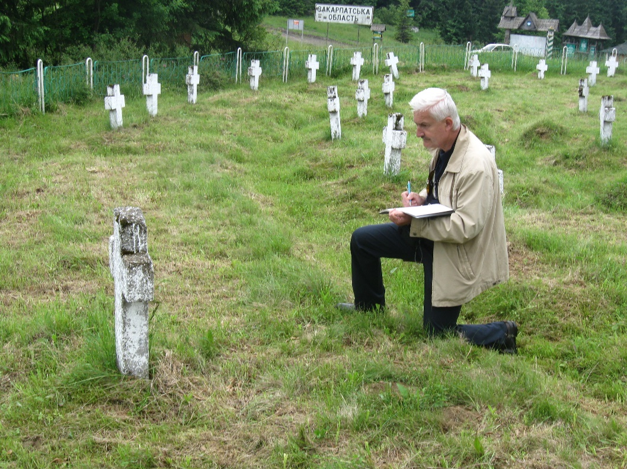
Cemeteries-”twins” on Torun Pass

Slide 20
Torun Pass. 5.09.20. Placing of information table and clearing of cemetery by “Memento bellum” members

Slide 21
One of the reconstruction versions

Slide 22
Bohumil Krs (1890 – 1962) – famous Czech painter. 03.-06.1915.– kadet of infanterian regiment №35 (Plzen) on Carpathian battlefields (Torun Pass – Halicz) where was wounded. “Tam jsem ztratil studentskou lásku a nohu. To posílilo můj optimistickỳ názor na život”.

Slide 24
Church of St.Demetrius (1780) in Repynne village

Slide 26
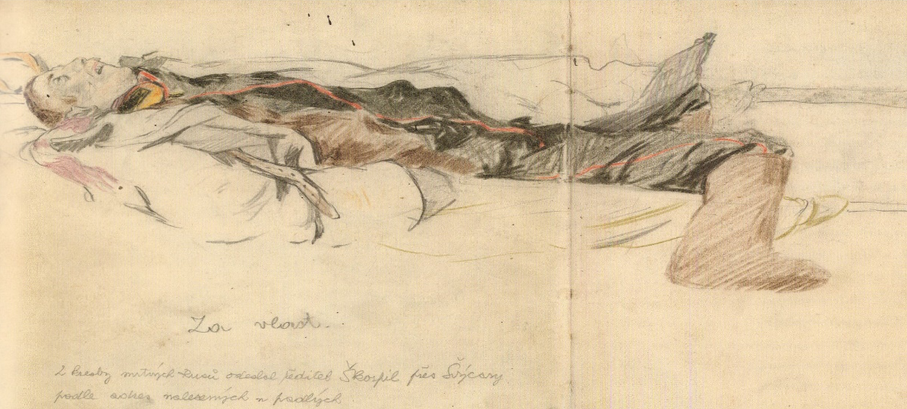

Slide 28
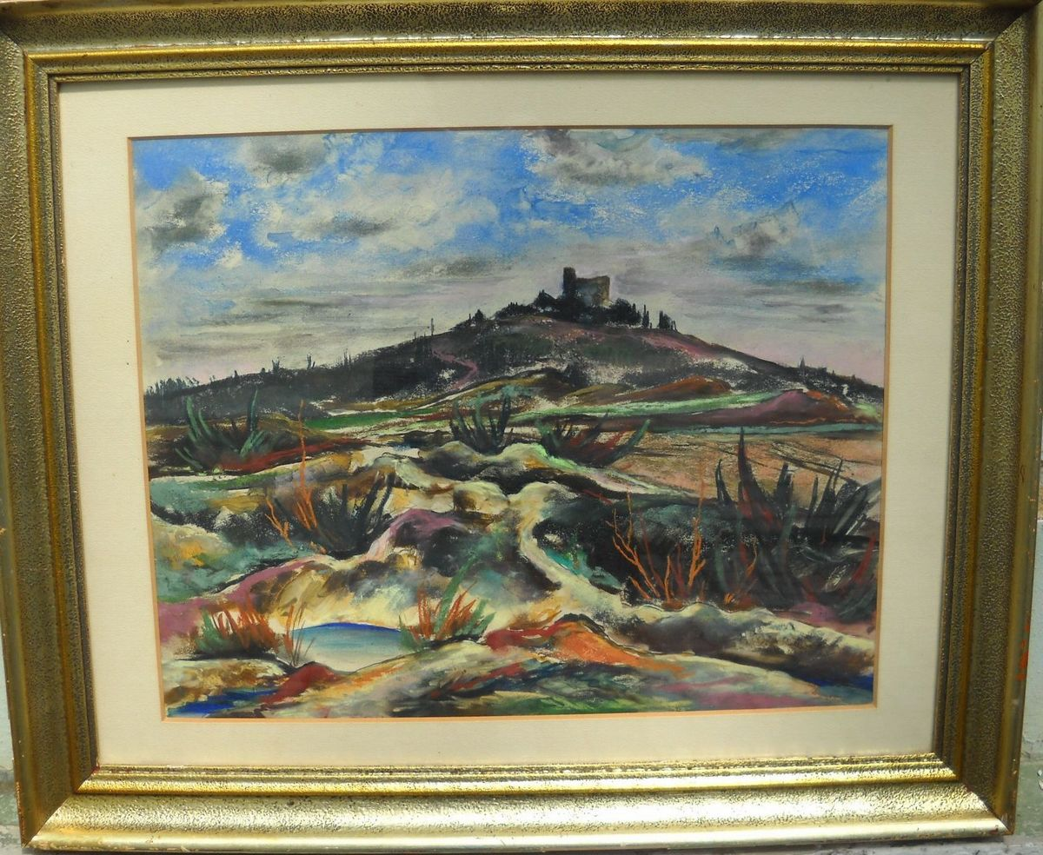
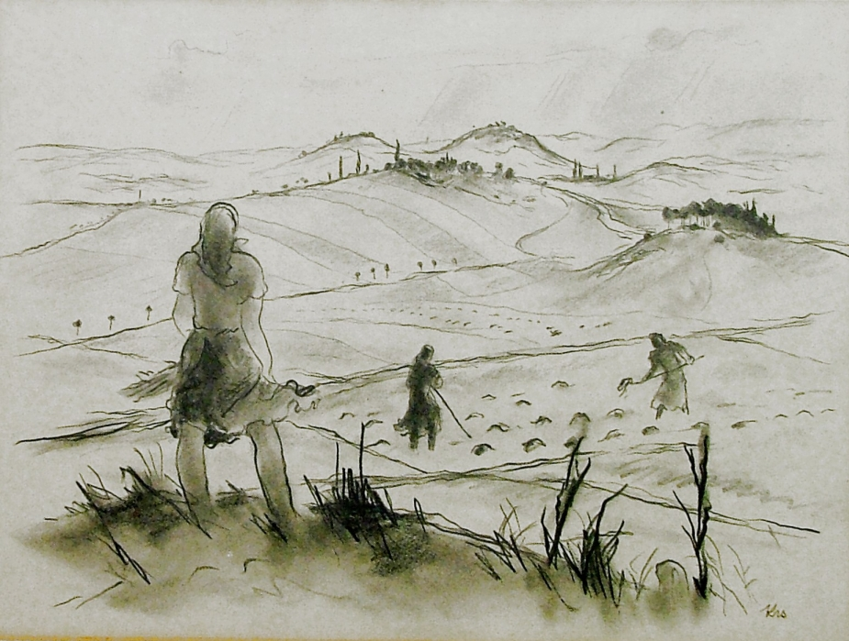
Post-war pictures of Bohumil Krs

Slide 29
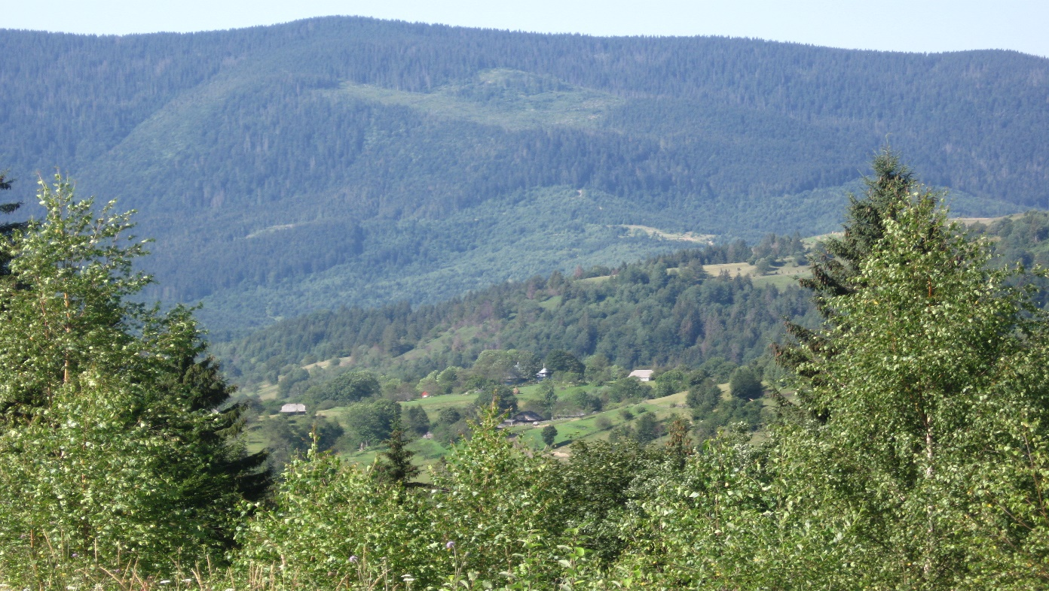
Military cemeteries in Carpathian Mountains

Slide 30
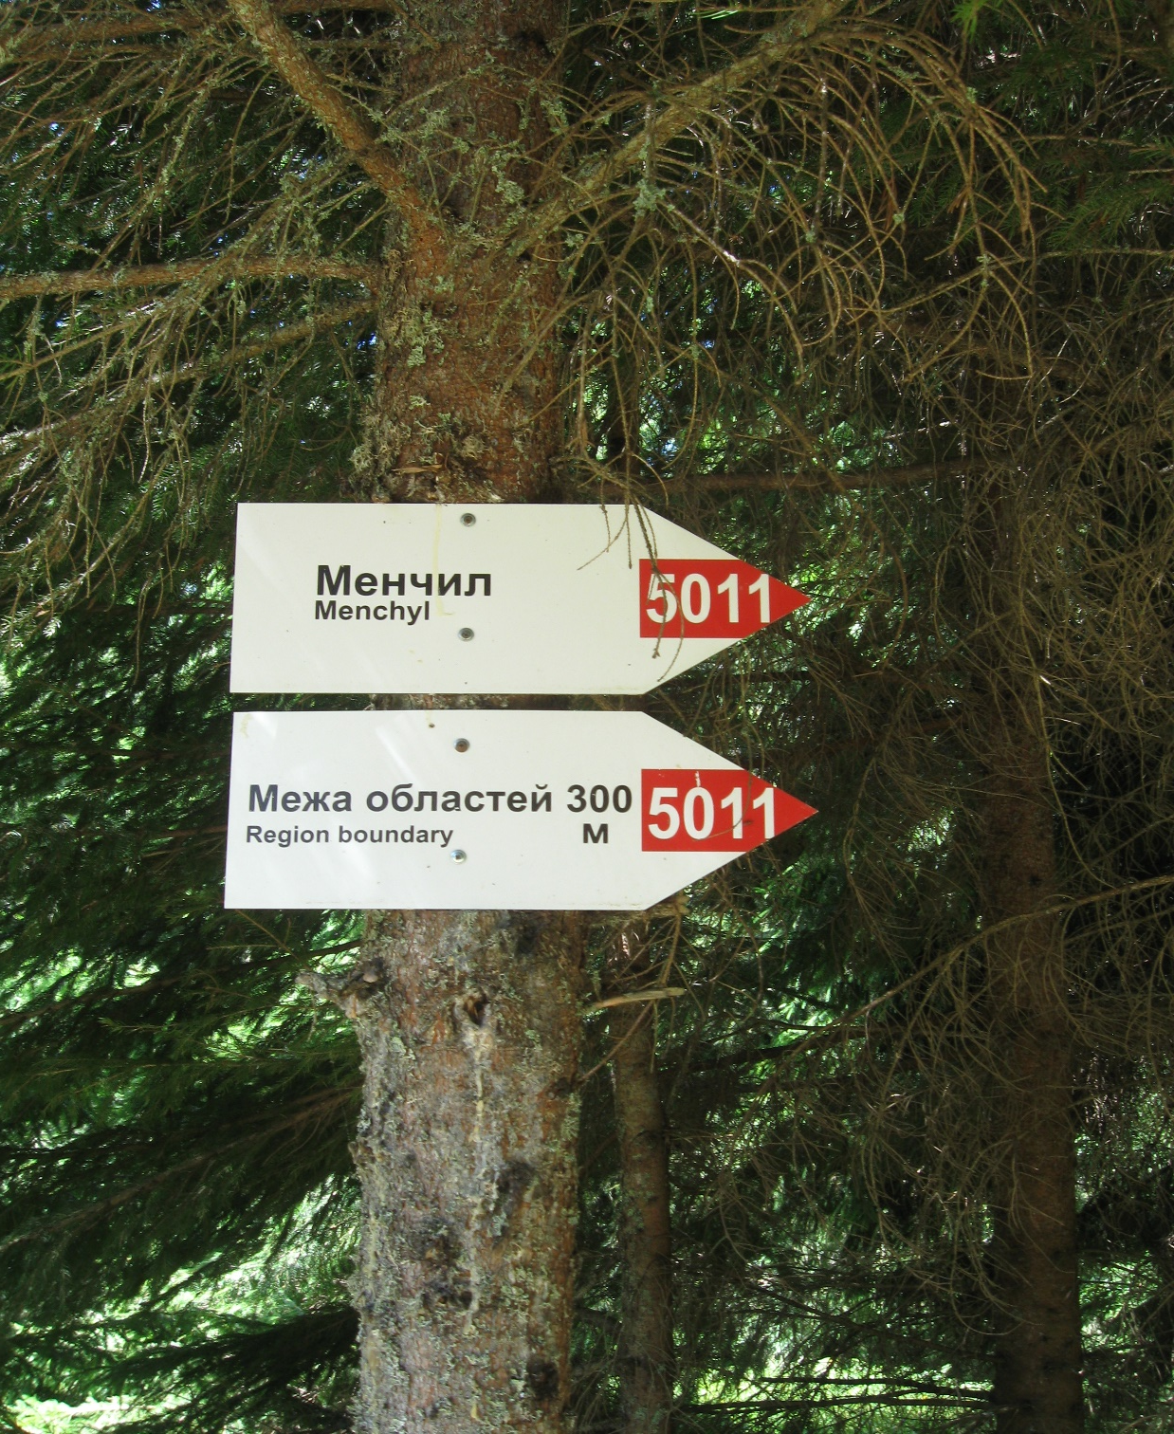
Military cemetery on mountain 1144 near Zavijka 18 Soldiers buried

Slide 31
Military cemeteries in Mizhirja

Slide 32
Military cemetery in Mizhhirja 148 Soldiers buried.

Slide 33
Military cemetery in Mizhhirja 350 Soldiers buried.

Slide 34
Military cemetery in Sinevyrska Poljana. 24 Soldiers buried.

Slide 35
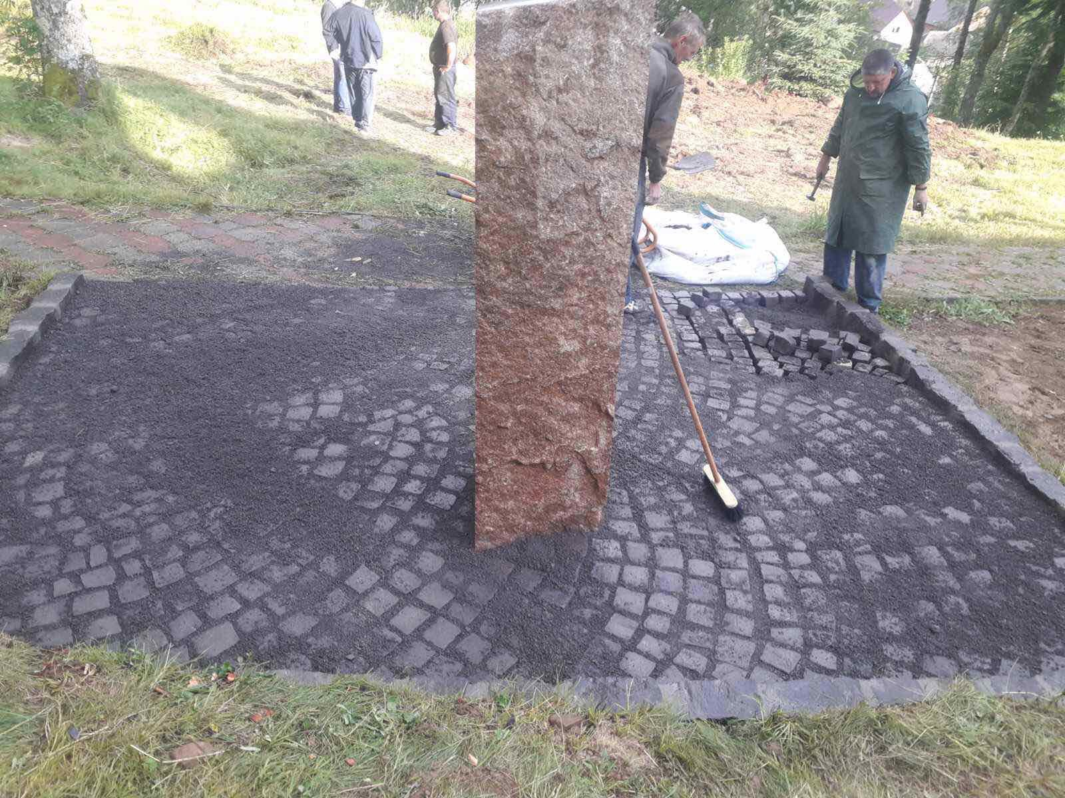
Sinevyrska Poljana. 16.07.2020. Placing of monument on military cemetery of World War I by “Memento bellum”.

Slide 36
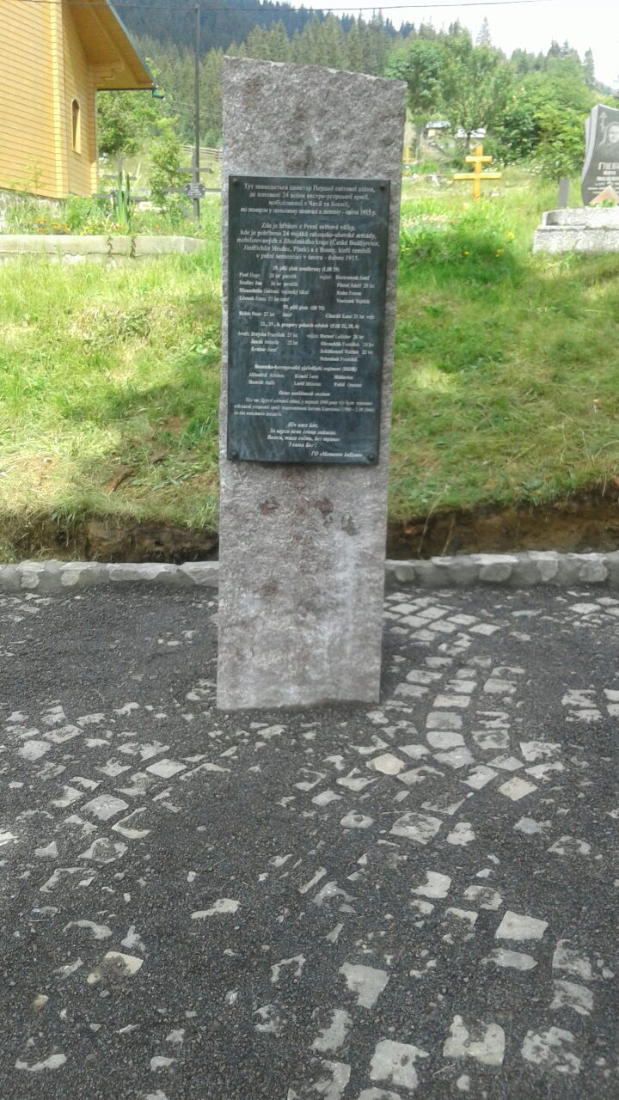
Sinevyrska Poljana. Monument on military cemetery of World War I .

Slide 37
Plan of further reconstruction

Slide 38
Military cemeteries (27) in Velykij Bereznij region (3605 buried soldiers). Military cemetery on Uzhok Pass Military cemetery on Czeremcha (363 buried soldiers) mountain (654 buried soldiers)

Slide 39
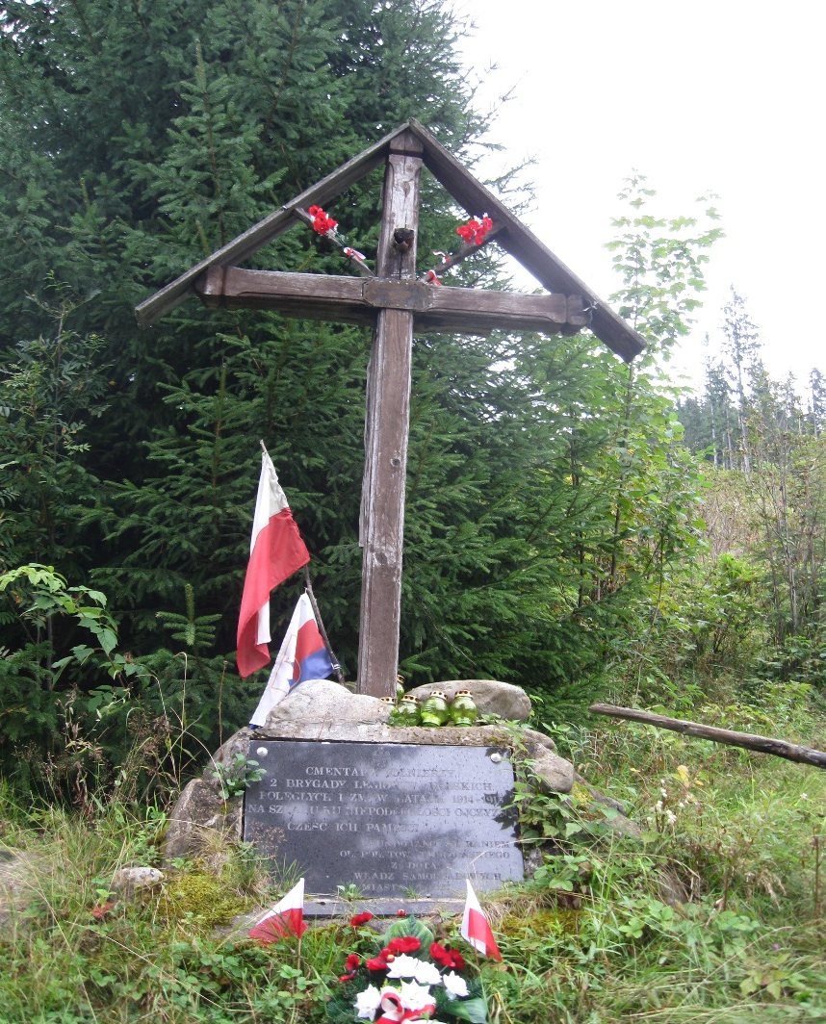
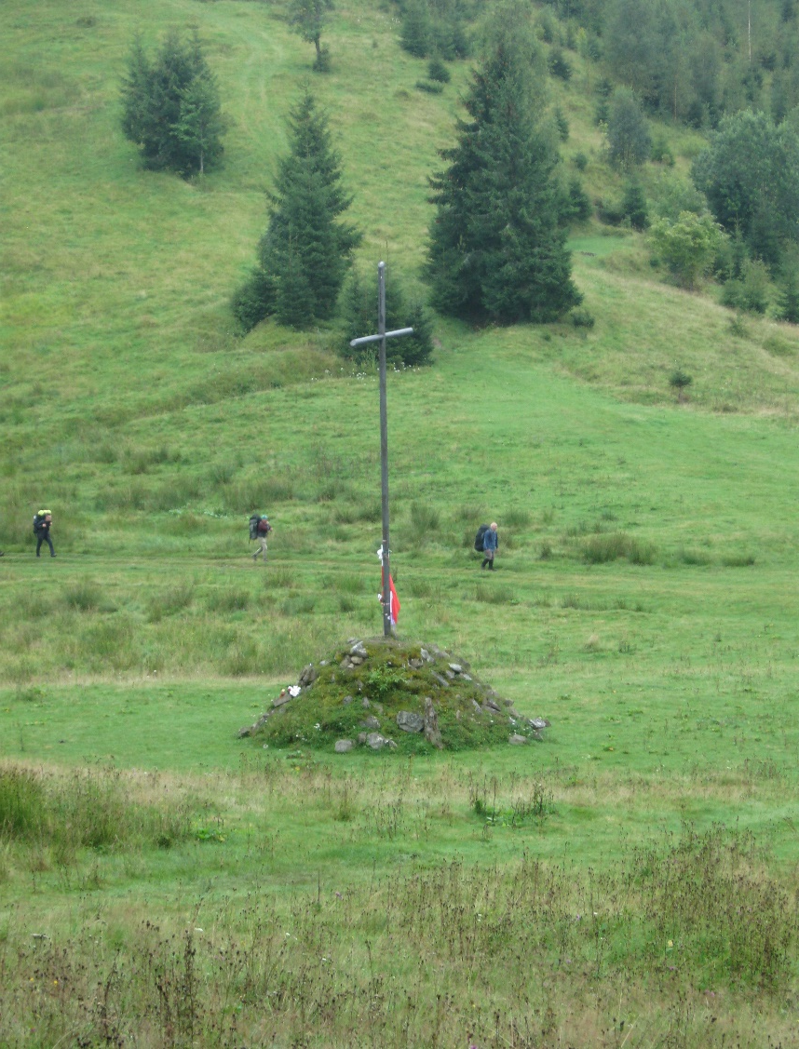
Memorable cross and military cemetery on Legion Pass

Slide 41
Number of World War I military cemeteries and buried soldiers only in four districts of Transcarpathian region of Ukraine according to the documents of Czech military archive (Prague)
Location of military cemeteries | Number of cemeteries | Number of buried soldiers
Military cemeteries in Uzhhorod | 2 | 12.000.
Military cemeteries in Mukachevo | 2 | 1.100.
Military cemeteries in Velykij Bereznij region | 27 | 3.605.
Military cemeteries in Mizhirja region | 15 | 1.400.
 | 46 | 18.105

Slide 42
Thank you for attention.
Дякую за увагу.

